Slide 1
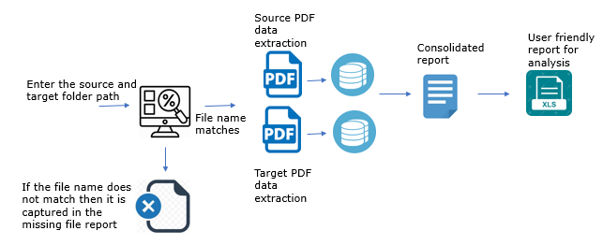
PDF Comparison Case Study
Problem Statement
As a part of Obsolescene Crystal report migration the new PDF had to be compare with the earlier generated report for the font style, alignment, data content.
Comparing multiple PDF’s of previous version and new version is a tedious, time consuming and error prone if done manually.
The statement reports that are validated are usually more than 5 pages which necessitates the need for having an automated approach for validation.
PDF Comparison Solution
Solution Highlights
A textual based hybrid approach was designed which validated the entire PDF for the below scenarios
Bulk validation of PDF based on the source and target path
Complete data/Content validation
Alignment validation
Font style/size validation
Data wrapping content is separately highlighted.
Challenges/Limitations
Image based validations like Logo/ Official stamps, signature on the scanned copies, etc. are not validated.
The header section is excluded in the current version.
Handling multi language PDFs is a challenge, it’s a Work in-progress to find the optimum solution.
Benefits
Bulk validation of PDF is possible.
A 8 page PDF takes less than 2 minute for the entire validation.
User friendly report that clearly calls out which page , line of the PDF has an error.
It further segregates the issue based on Content, Font style and alignment category
1

Slide 2
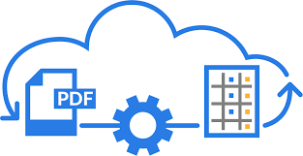


Source PDF
data extraction
Enter the source and target folder path
File name
matches
Target PDF
data extraction
If the file name does not match then it is captured in the missing file

Slide 3
Source PDF
data extraction
Enter the source and target folder path
File name
matches
Target PDF
data extraction
If the file name does not match then it is captured in the missing file

Slide 4


Source PDF
data extraction
Enter the source and target folder path
File name
matches
Target PDF
data extraction
If the file name does not match then it is captured in the missing file report

Slide 5

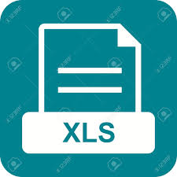
PDF Comparison Utiltiy
User friendly report for analysis
Source PDF
data extraction
Consolidated report
Enter the source and target folder path
File name
matches
Target PDF
data extraction
If the file name does not match then it is captured in the missing file report

